Slide 1




|| Jai Sri Gurudev || Sri Adichunchanagiri Shikshana Trust®
SJB INSTITUTE OF TECHNOLOGY
Department of Electronics & Communication Engineering
Project Phase II
Presentation on
An Approach towards Development and Analysis of Smart Aeroponic System
Presented By
Chethan S 1JB19EC022
Indupriya B 1JB19EC029
Kruthi N 1JB19EC041
Manjukishore P 1JB19EC050
Under the guidance of
Dr. Chandrappa D N
Professor & HOD
Dept. of ECE, SJBIT

Slide 2
CONTENTS
Introduction
Literature Survey
Problem Statement
Challenges
Objectives
Proposed Methodology
Block diagram
Flowchart
Results
Application
Reference
Stages of the work
Future Scope

Slide 3
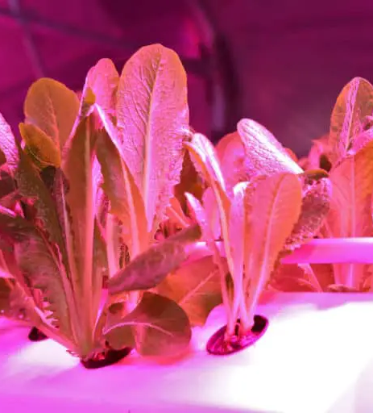
Abstract
This project discusses the design and implementation of an IoT-based aeroponic farming system. The system involves growing plants in a nutrient-rich mist, while an IoT platform is used to monitor and control various aspects of the farming process.
The project provides a step-by-step guide on how to design and implement the system, including defining the requirements, designing the system components, selecting IoT sensors, choosing an IoT platform, implementing the IoT system, testing and optimizing, and monitoring and maintaining the system.
The benefits of an IoT-based aeroponic farming system are also highlighted, such as increased yield, reduced water usage, and improved plant growth rates.

Slide 4

INTRODUCTION
Aeroponics makes use of mist such that plant's roots are suspended in a mist container, while the rest of the plant sits above the setup.
This aeroponics is an automated, partially enclosed system that enables consumers to grow their own high-quality produce within the constraints of an urban environment with minimal oversight or expertise.
An innovative design and prototype with functional software have been developed. A microcontroller and series of sensors and actuators regulate lighting, temperature, humidity and nutrient delivery. A web interface provides monitoring to the user.
Results can be shared through this network to create a continuously improving community.

Slide 5
LITERATURE SURVEY
Author name | Title | Year | Inference | Limitations
Shyamal Patel and Dr Lance Erickson | Project XGEN | 2011 | sophisticated and modern than the previous apparatuses | Lacked feedback mechanism.
Y.W.Z.Jing Liu | An automated aeroponic growth system based on ultrasonic atomization. | 2013 | Monitoring temperature and conductivity. | Temperature monitoring only.
V.Arenella | Automatic aeroponic irrigation system based on Arduino platform. | 2016 | Real time data was logged and streamed to web server. | Data mining and analysis only.
Stephen C. Kerns Joong-Lyul Lee | Automated Aeroponics System Using IoT for Smart Farming | 2017 | Introduction of a new application using Raspberry pi zero | High cost and minimal usage of this device.
M Rakib Uddin and M F Suliaman | Energy efficient smart indoor fogponics farming system | 2021 | Fog is produced by placing an ultrasonic fog generator | Fog generator produces more heat and consumes more power due to its usage which increases the temperature of the chamber

Slide 6

LITERATURE GAP
The limitations found in survey papers are overcome in our proposed project
A simpler and efficient farming system is developed using limited number of sensors.
Temperature and humidity monitoring as well as controlling.
Sensor’s data is analyzed and sent to user through web server.
Implementing this system with low-cost installation and reducing the maintenance cost.

Slide 7

PROBLEM STATEMENT
Nowadays multiple factors affect the growth of plants in traditional agriculture methods. To overcome the drawback modern farming methods like vertical farming can be put into practice as this system is more reliable and cheaper than the other alternatives.

Slide 8
CHALLENGES
Prior knowledge regarding nutrients required.
To maintain the water droplet size (mist – 50 to 100 microns)
Web interfacing without router.
Plants die due to transplantation shock.
Maintaining constant pressure for all nozzles.

Slide 9
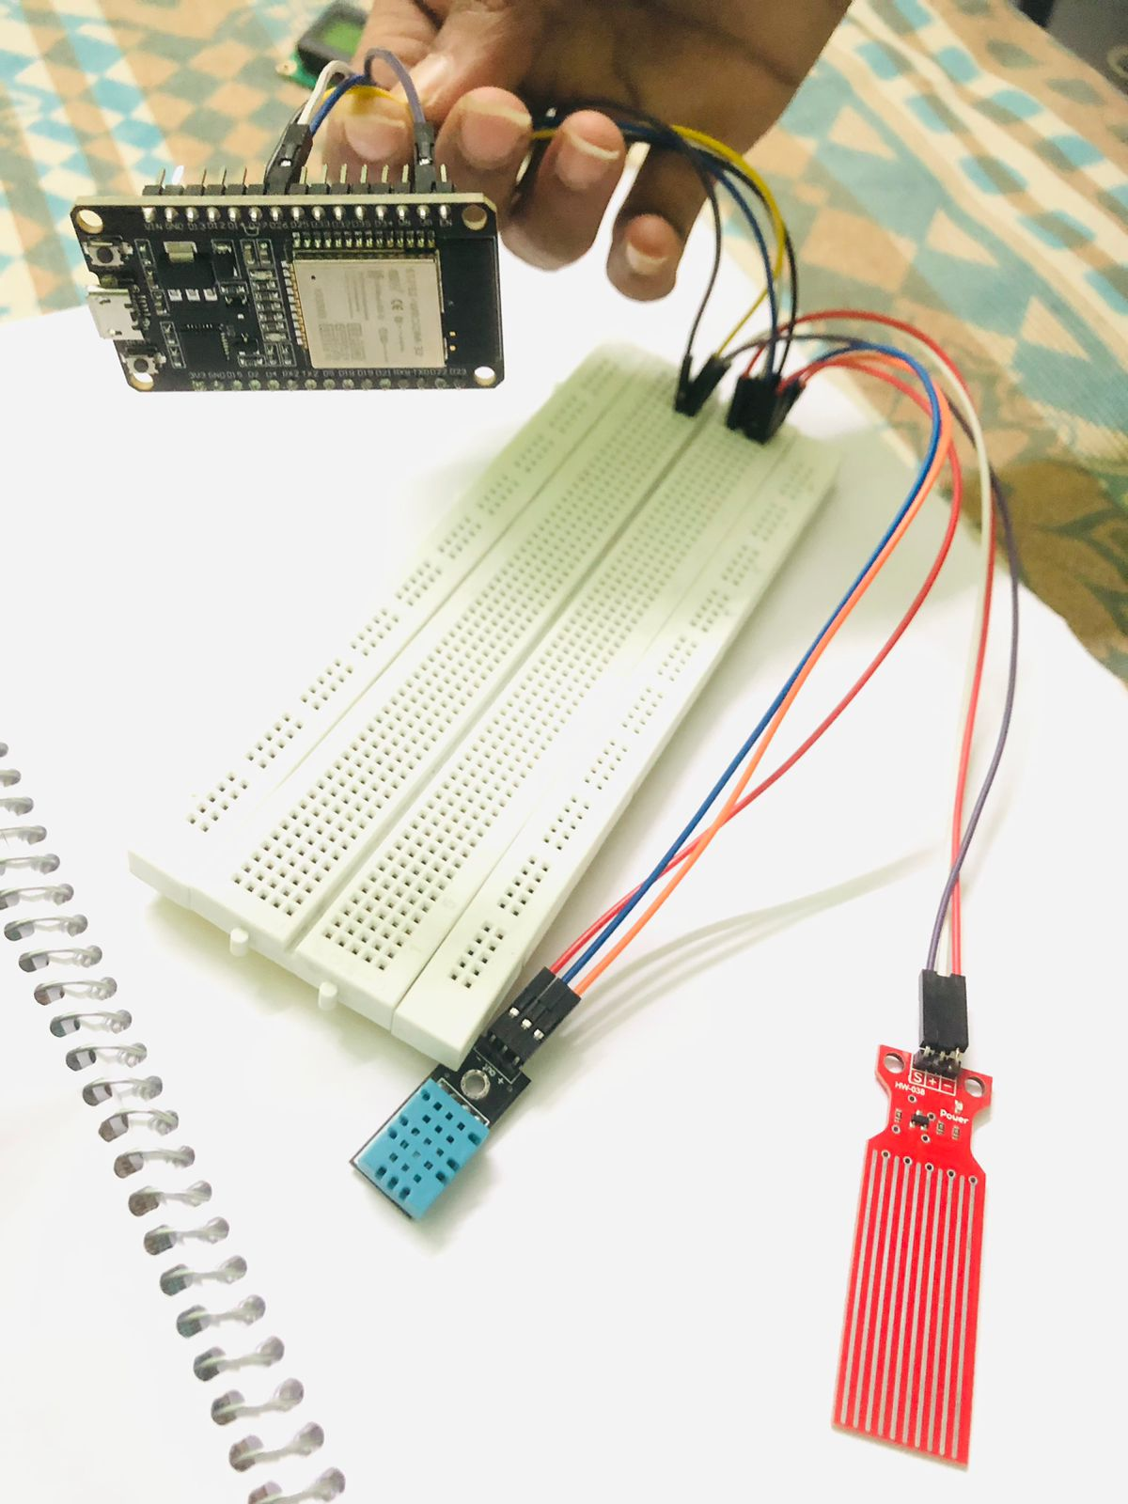
OBJECTIVES
Create a fully automated aeroponic system.
System must be relatively cheap and must be time efficient method for growing plant.
To eliminate seasonal dependency due to controlled and regulated environment.

Slide 10
PROPOSED METHODOLOGY
This methodology provides a modular “plug-and-play” aeroponic growth system which allows for efficient maintenance without any interruption.
An automated system controller that may implement pre-programmed spray operations, monitor, and control the temperature, humidity, light intensity and other suitable plant growth parameters.
Initiates alarms in the event of high or low sensor readings, pump failure, power failure or the occurrence of any other monitored process variable.
We designed a mobile interface that a user can easily check every sensor’s value in this system through a webserver which displays sensor’s data such as temperature, humidity and water level.

Slide 11
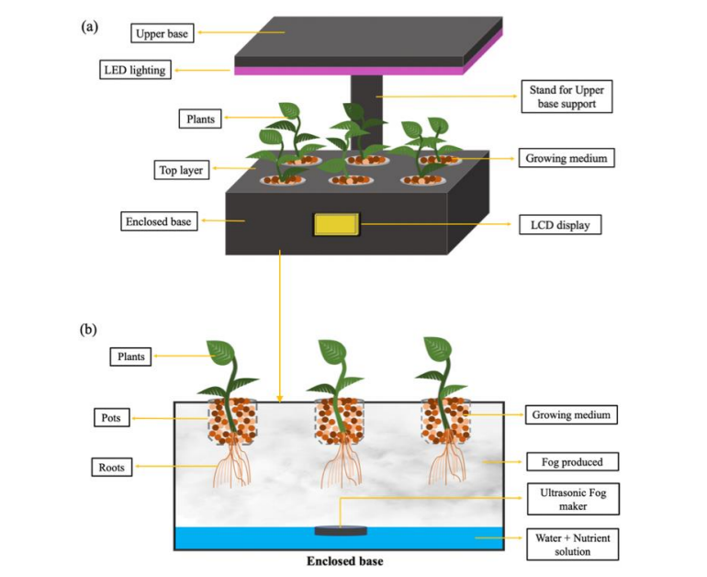
BLOCK DIAGRAM
BLOCK DIAGRAM
Mist produced
Mist nozzle

Slide 12
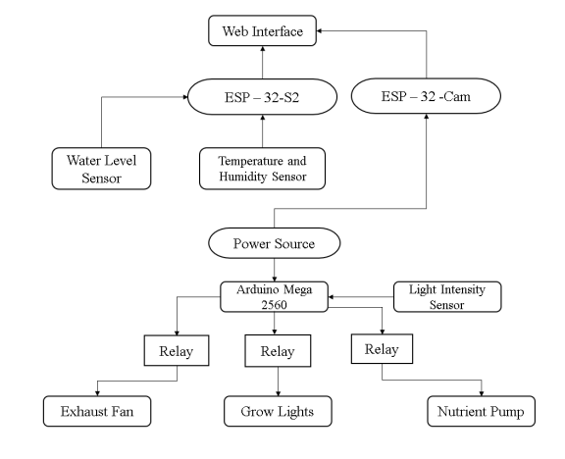
FLOWCHART
Analog shield

Slide 13
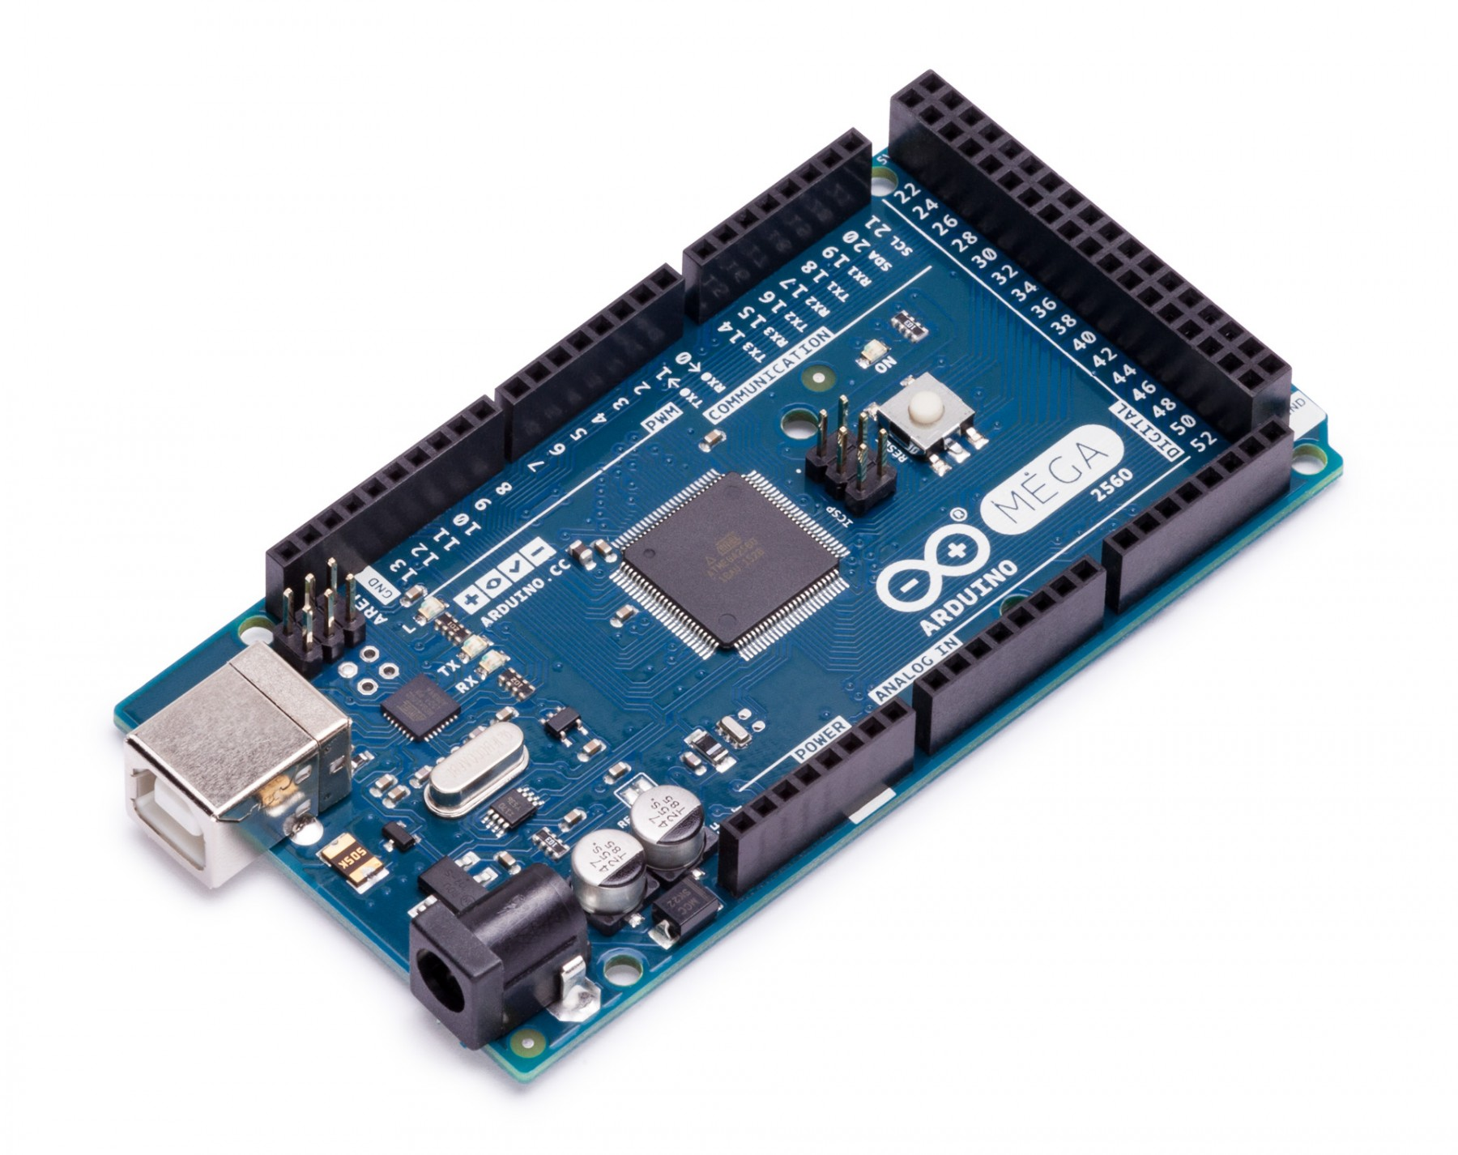
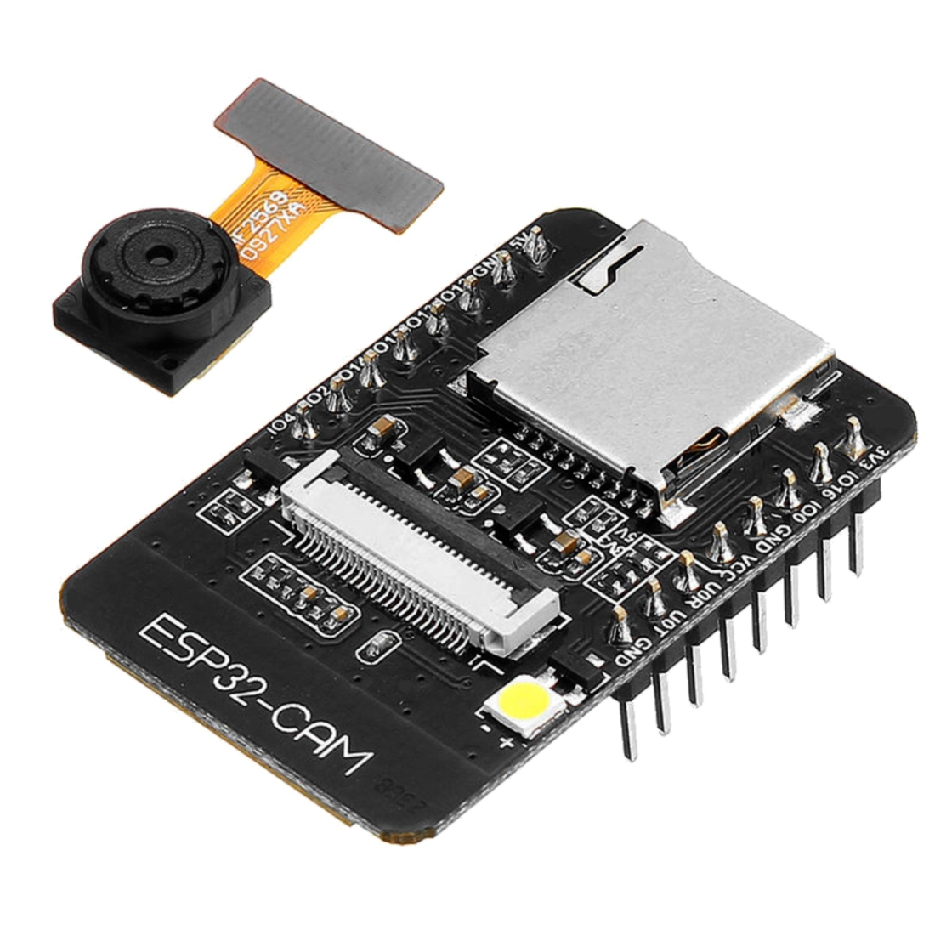
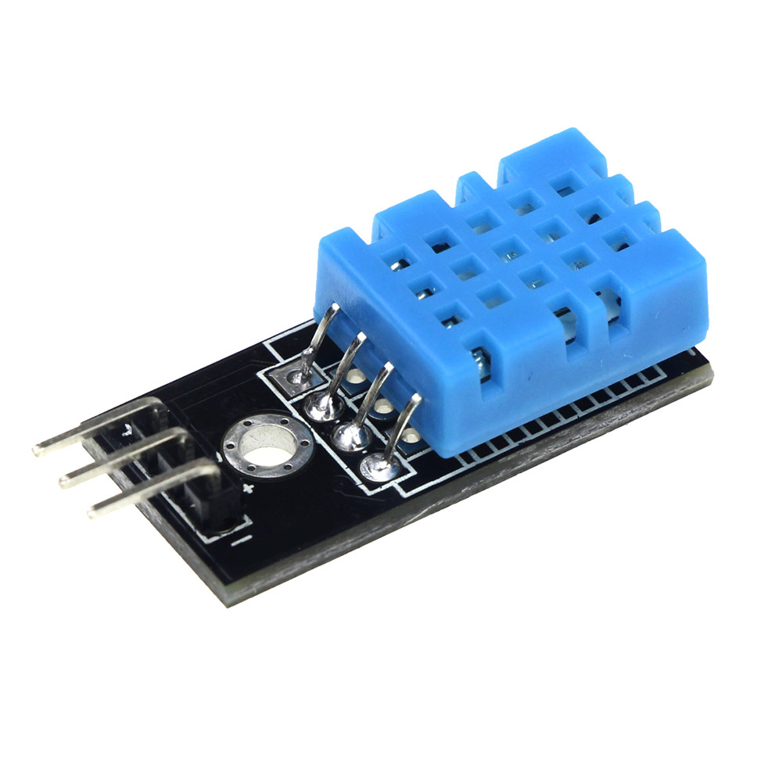
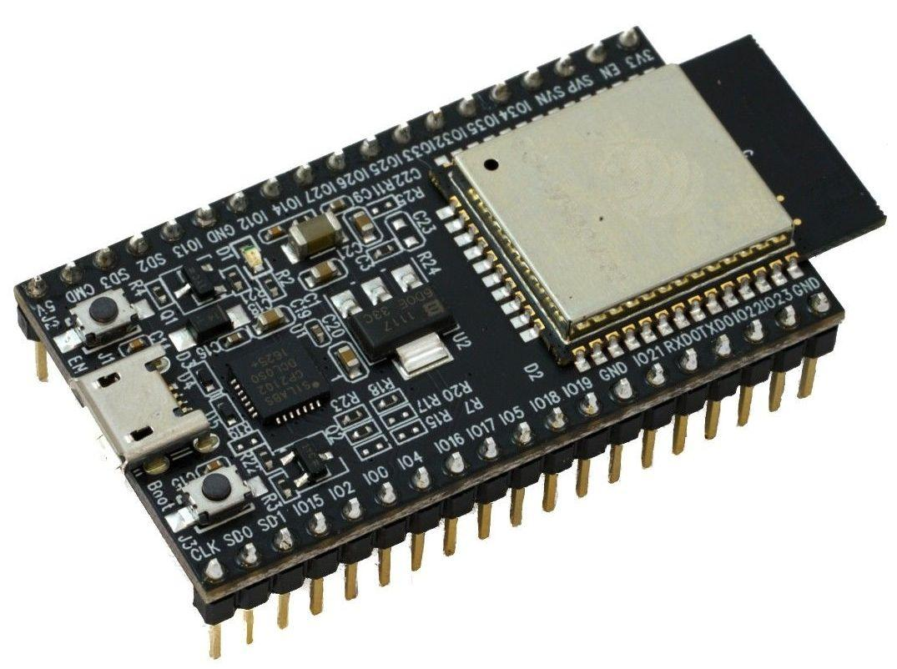
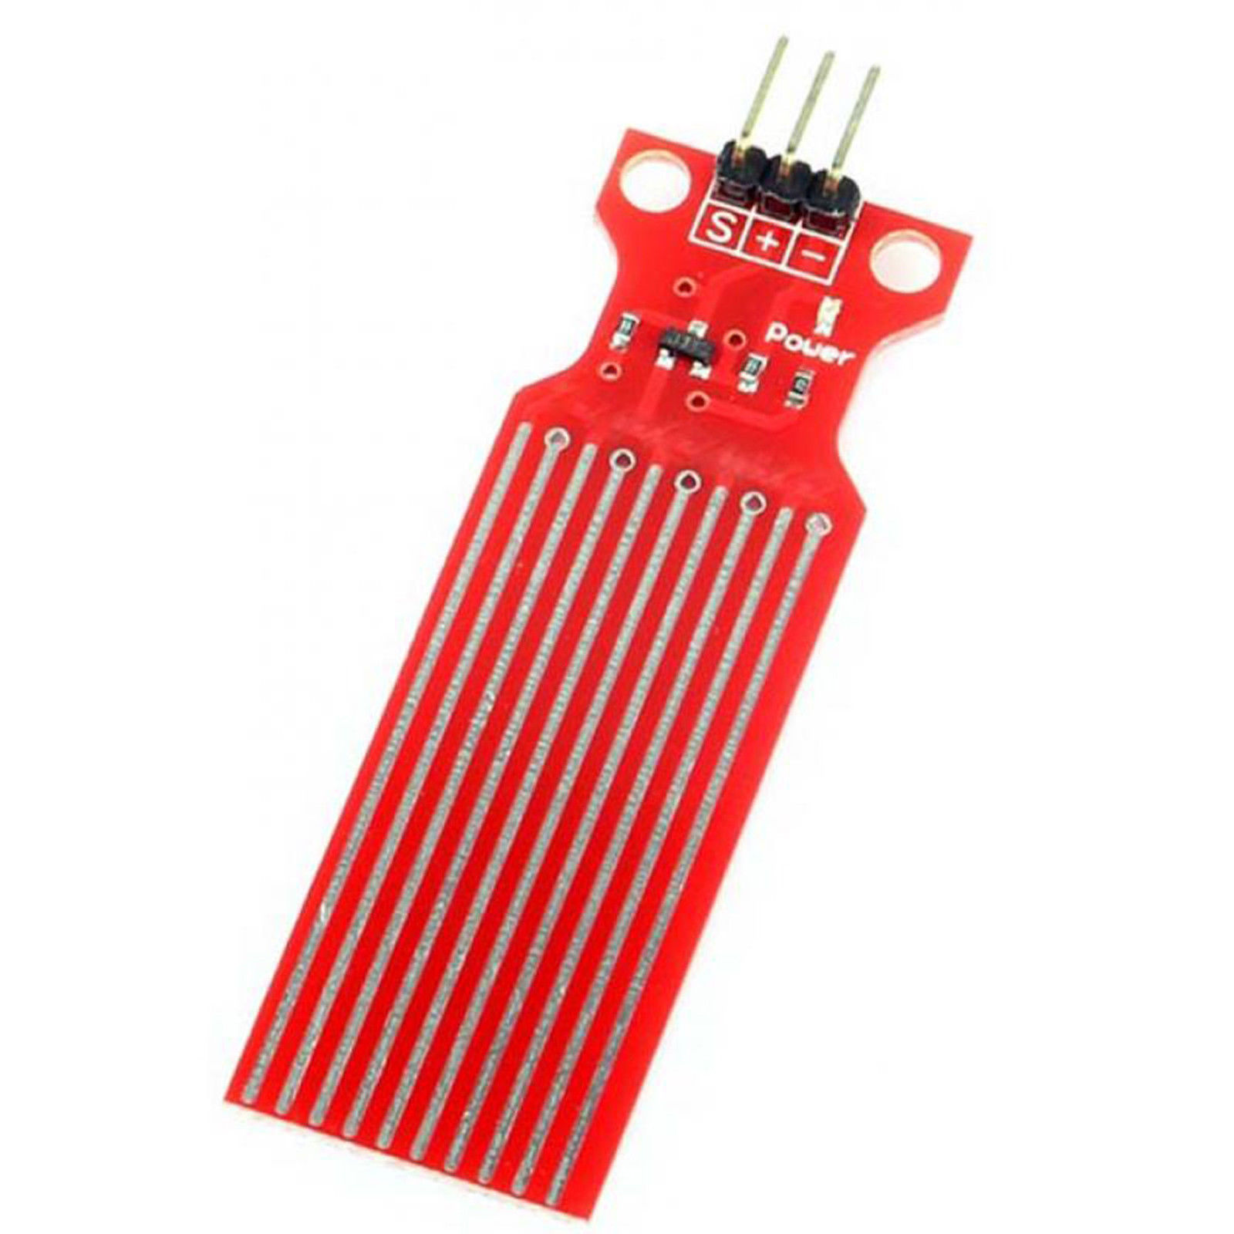
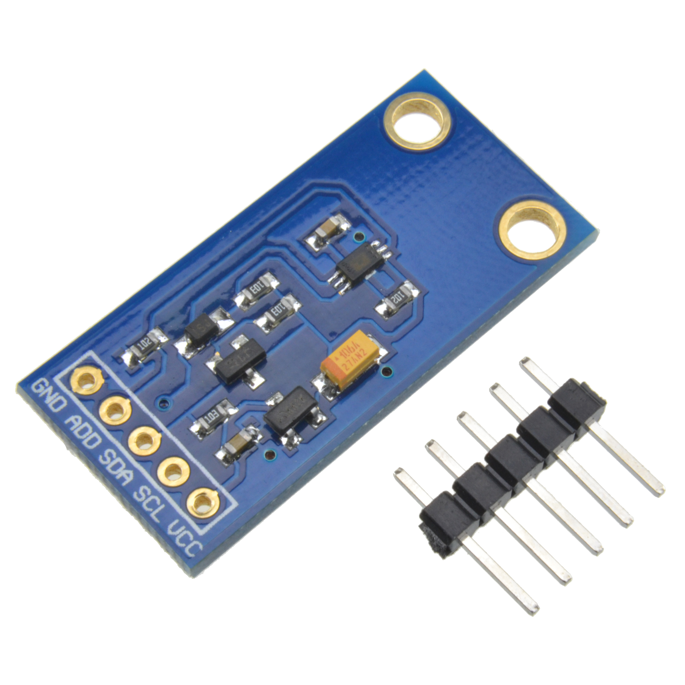
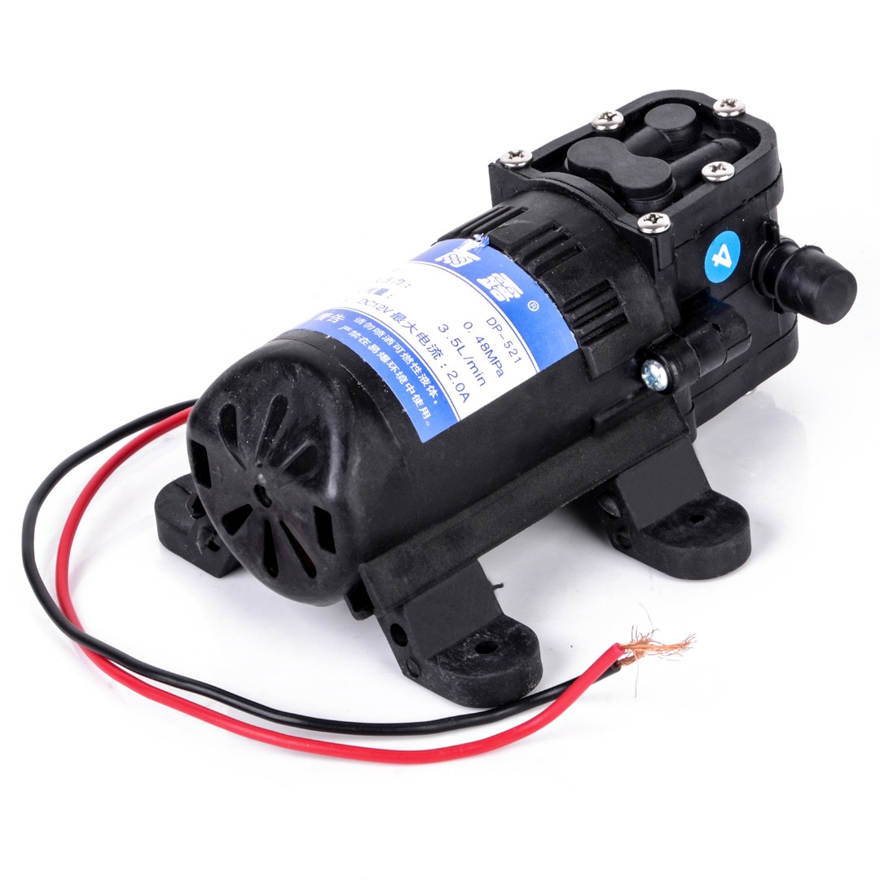
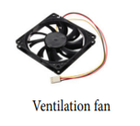
HARDWARE COMPONENTS
Arduino Mega
Esp32
Esp32 Camera module
Temperature & humidity sensor
Water level sensor
Light intensity sensor
High pressure Water pump
Grow lights

Slide 14
STAGES OF THE WORK
DEVELOPMENT OF HARDWARE MODEL OF AEROPONIC SYSTEM
ANALYSIS OF GROWTH OF PLANTS
DEVELOPMENT OF WEB SERVER
SMART AEROPONIC SYSTEM
Sensors, Arduino Mega, ESP-32-S2 , model fabrication, and other components are programmed and connected.
A microcontroller and series of sensors and actuators regulate lighting, temperature, humidity, nutrient delivery enrichment are connected. A web server provides monitoring and displaying on web server.
Analysis of growth of roots and shoot system and collect the sensor’s data to send it to web server

Slide 15
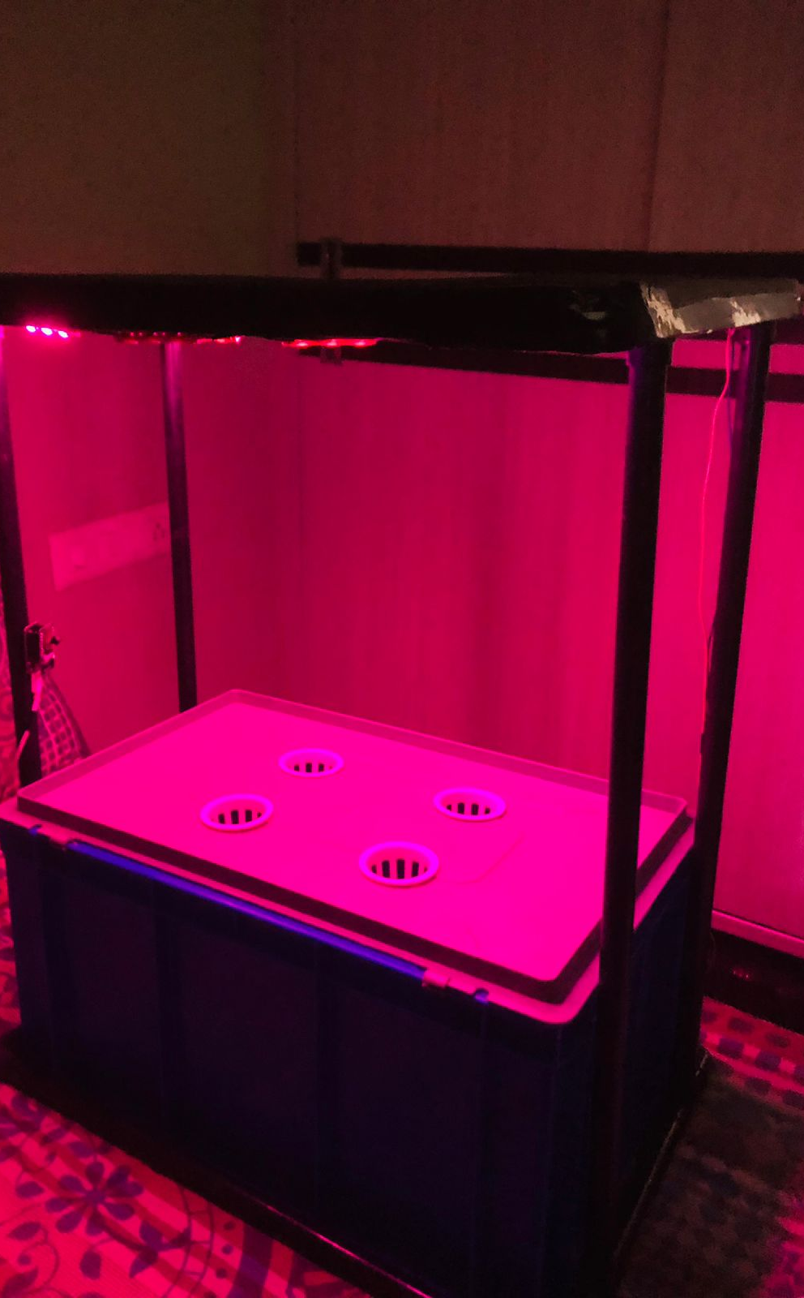
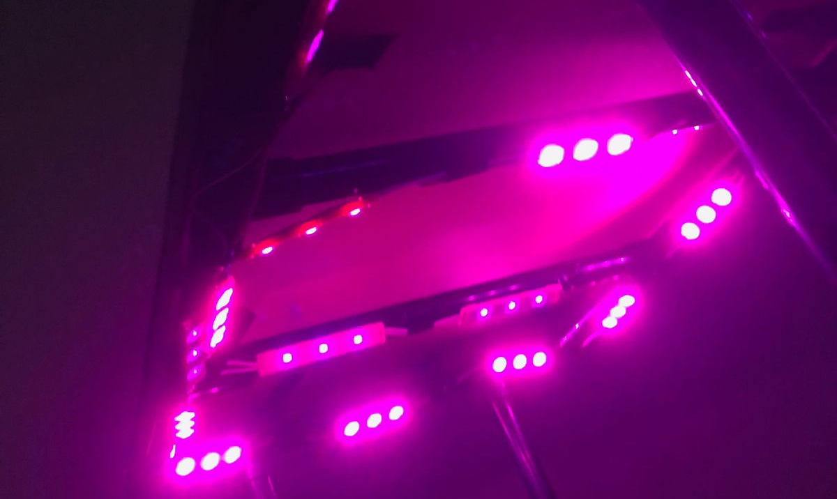
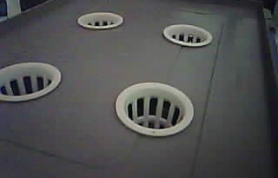
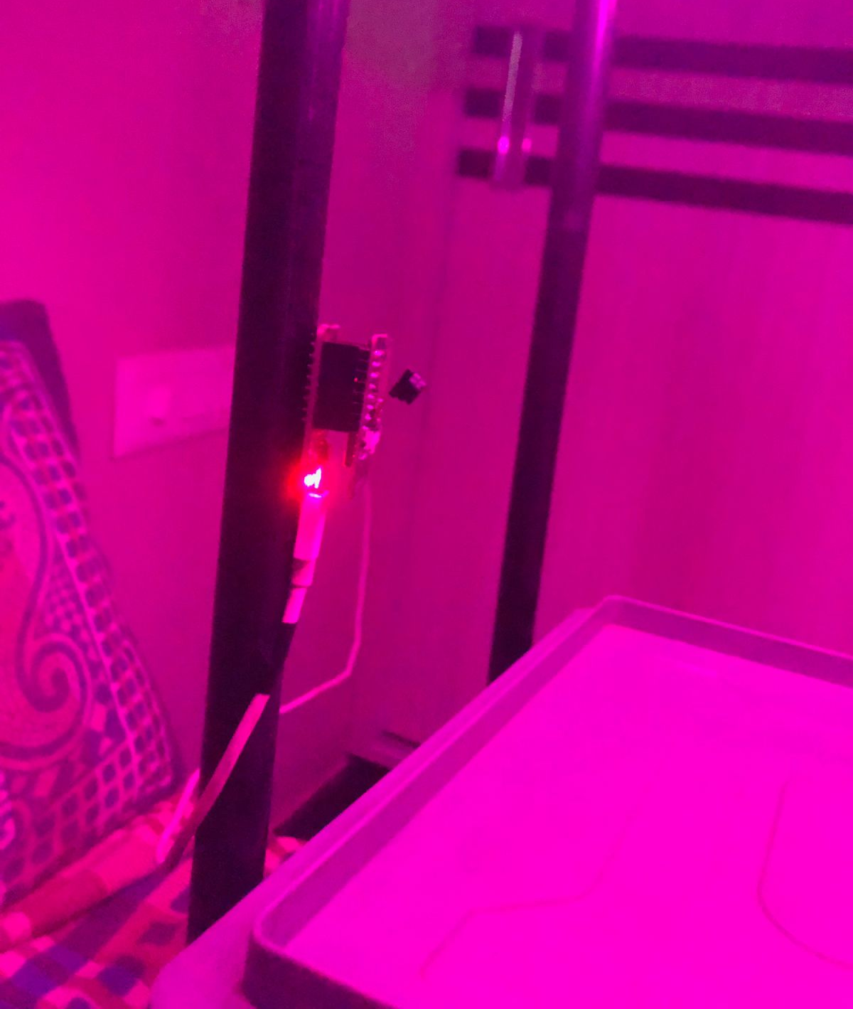
INITIAL SET-UP PHASE OF OUR SYSTEM
LED( GROW LIGHTS)
EARLY PROTOTYPE MODEL
IMAGE CAPTURED FROM ESP-32 CAM
POSITION OF CAMERA

Slide 16
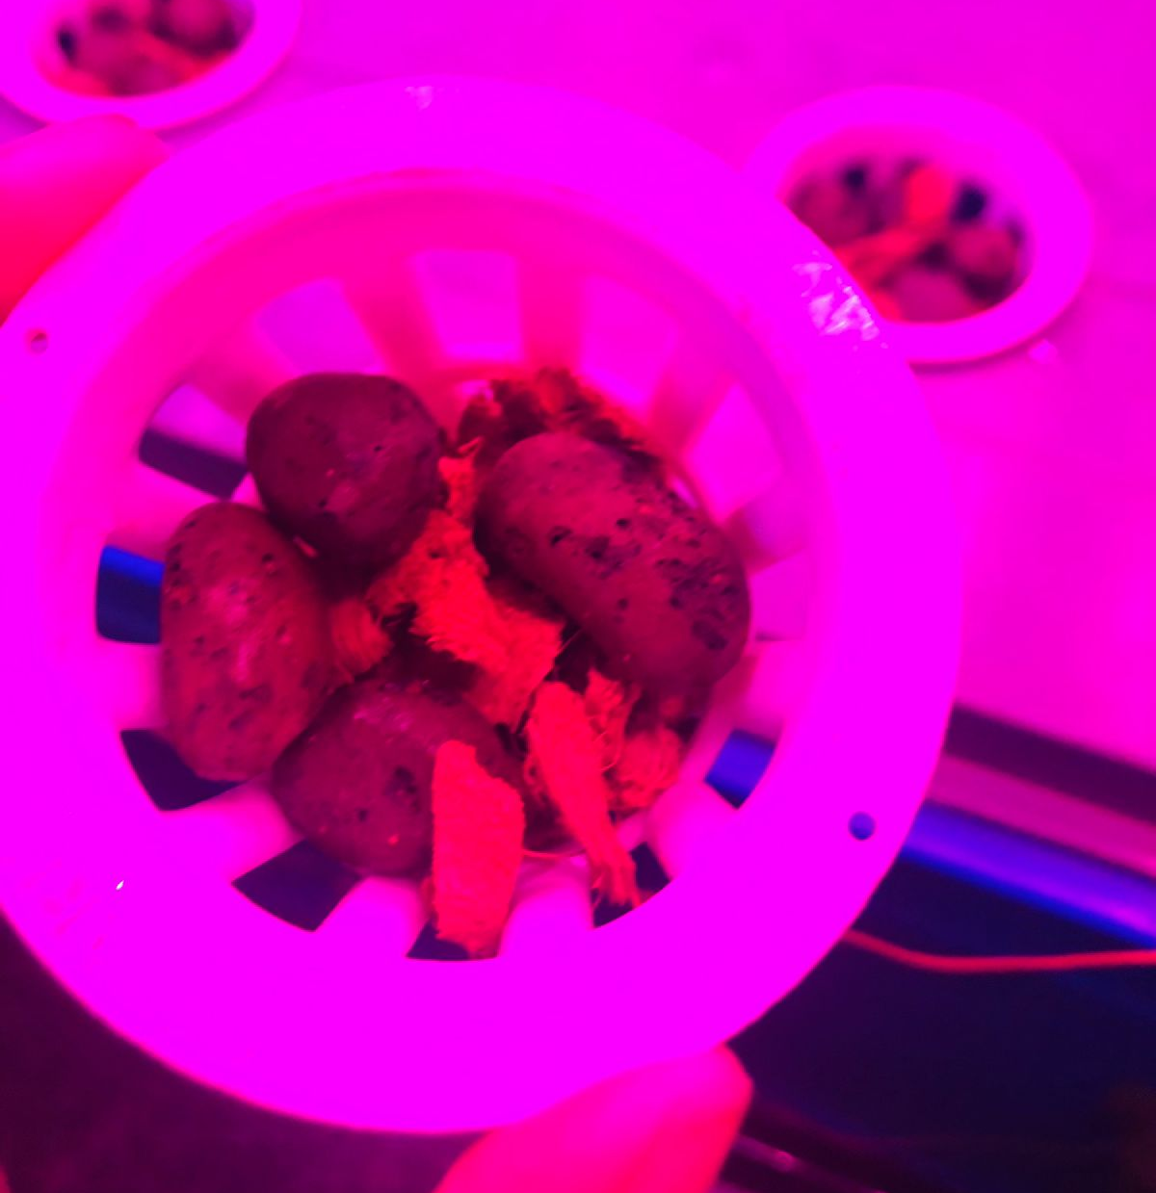
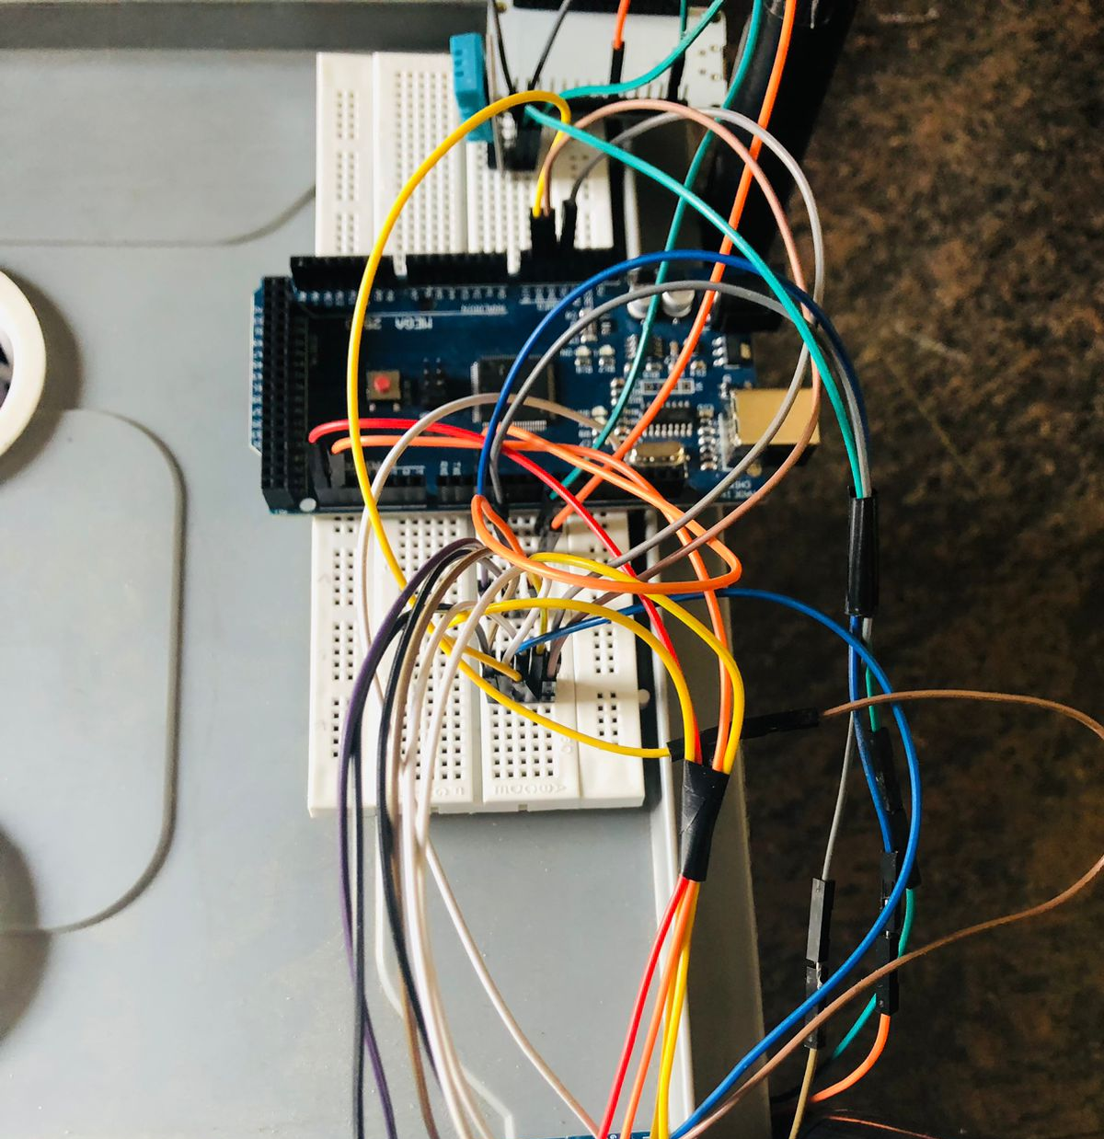
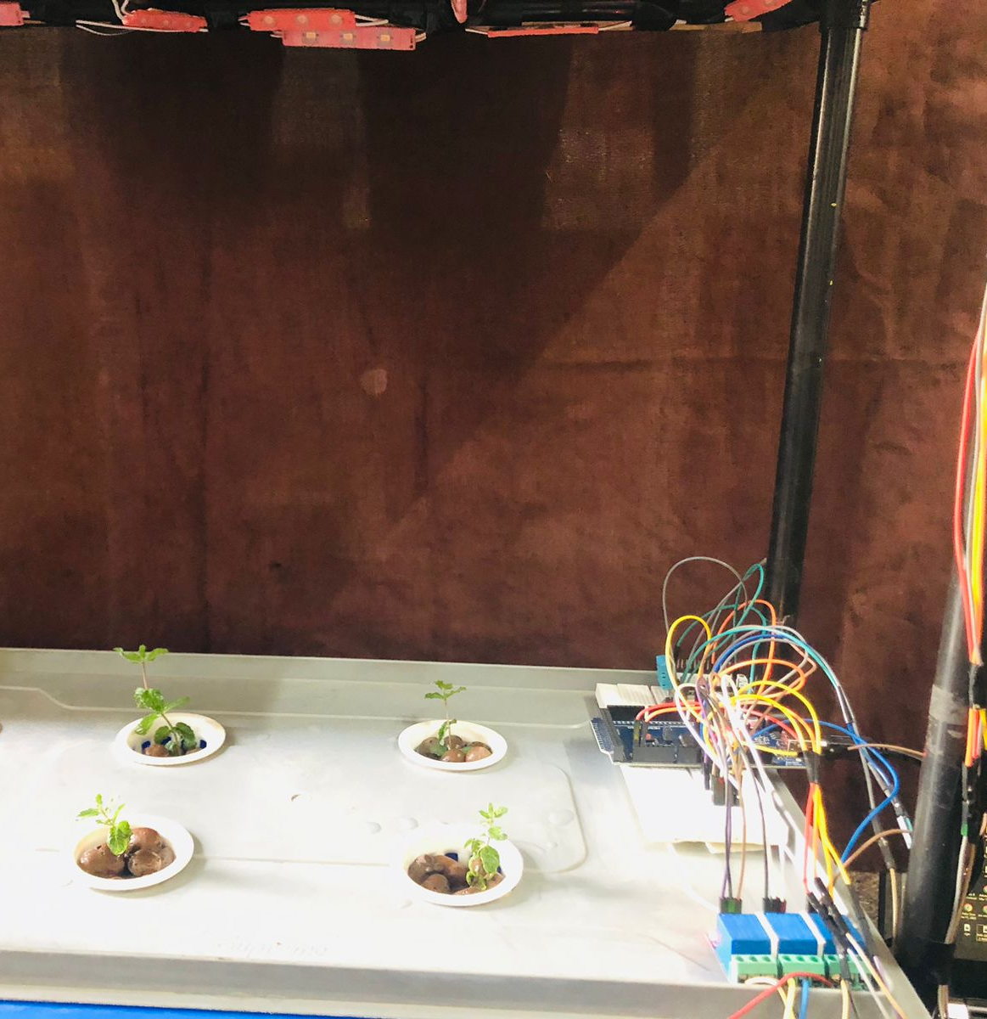
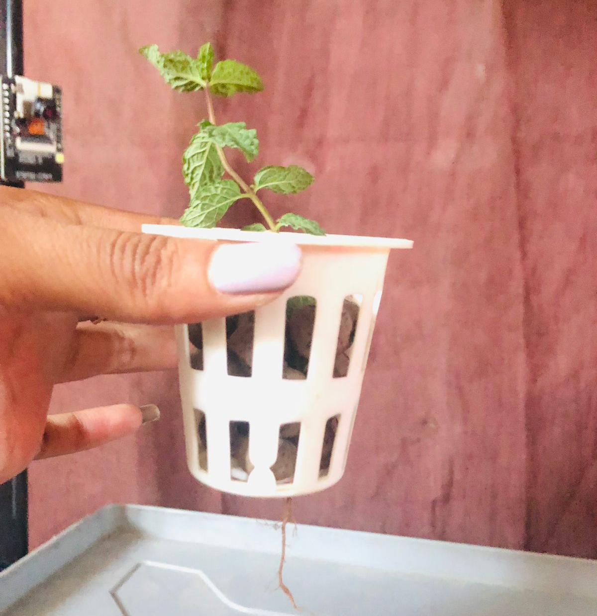
CIRCUIT AND COMPONENTS SET-UP
CLAY BALLS IN PLANT HOLDER
SENSOR AND IOT NETWORK
DAY 13-INITIAL SAMPLING TRANSPLANT PHASE
DAY 17 MINT PLANT GROWTH PHASE

Slide 17
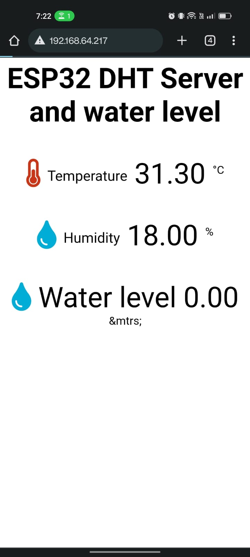
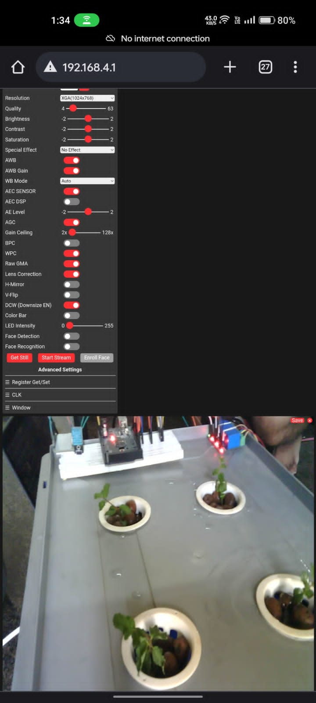
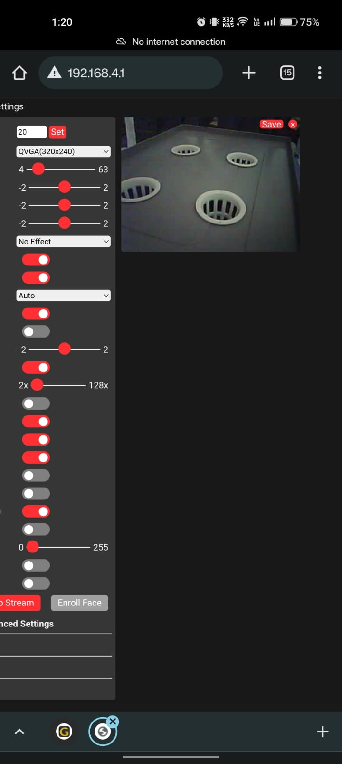
IMAGES OF WEB PAGE

Slide 18
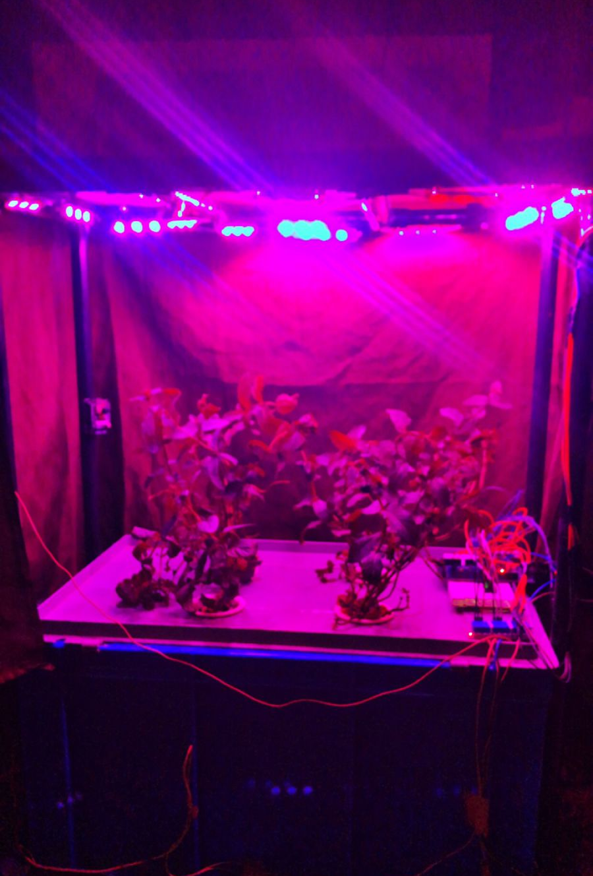
RESULTS
The growth rate of plants is increased.
This is an early prototype which may take some time to get commercially visualized.
With this prototype, we may get efficiency of about 50% to 60%.
The mint samplings showed a good growth in their sizes in the Aeroponic system. Each sample was placed as close as possible. But this positioning was not a hindrance for their growth.

Slide 19
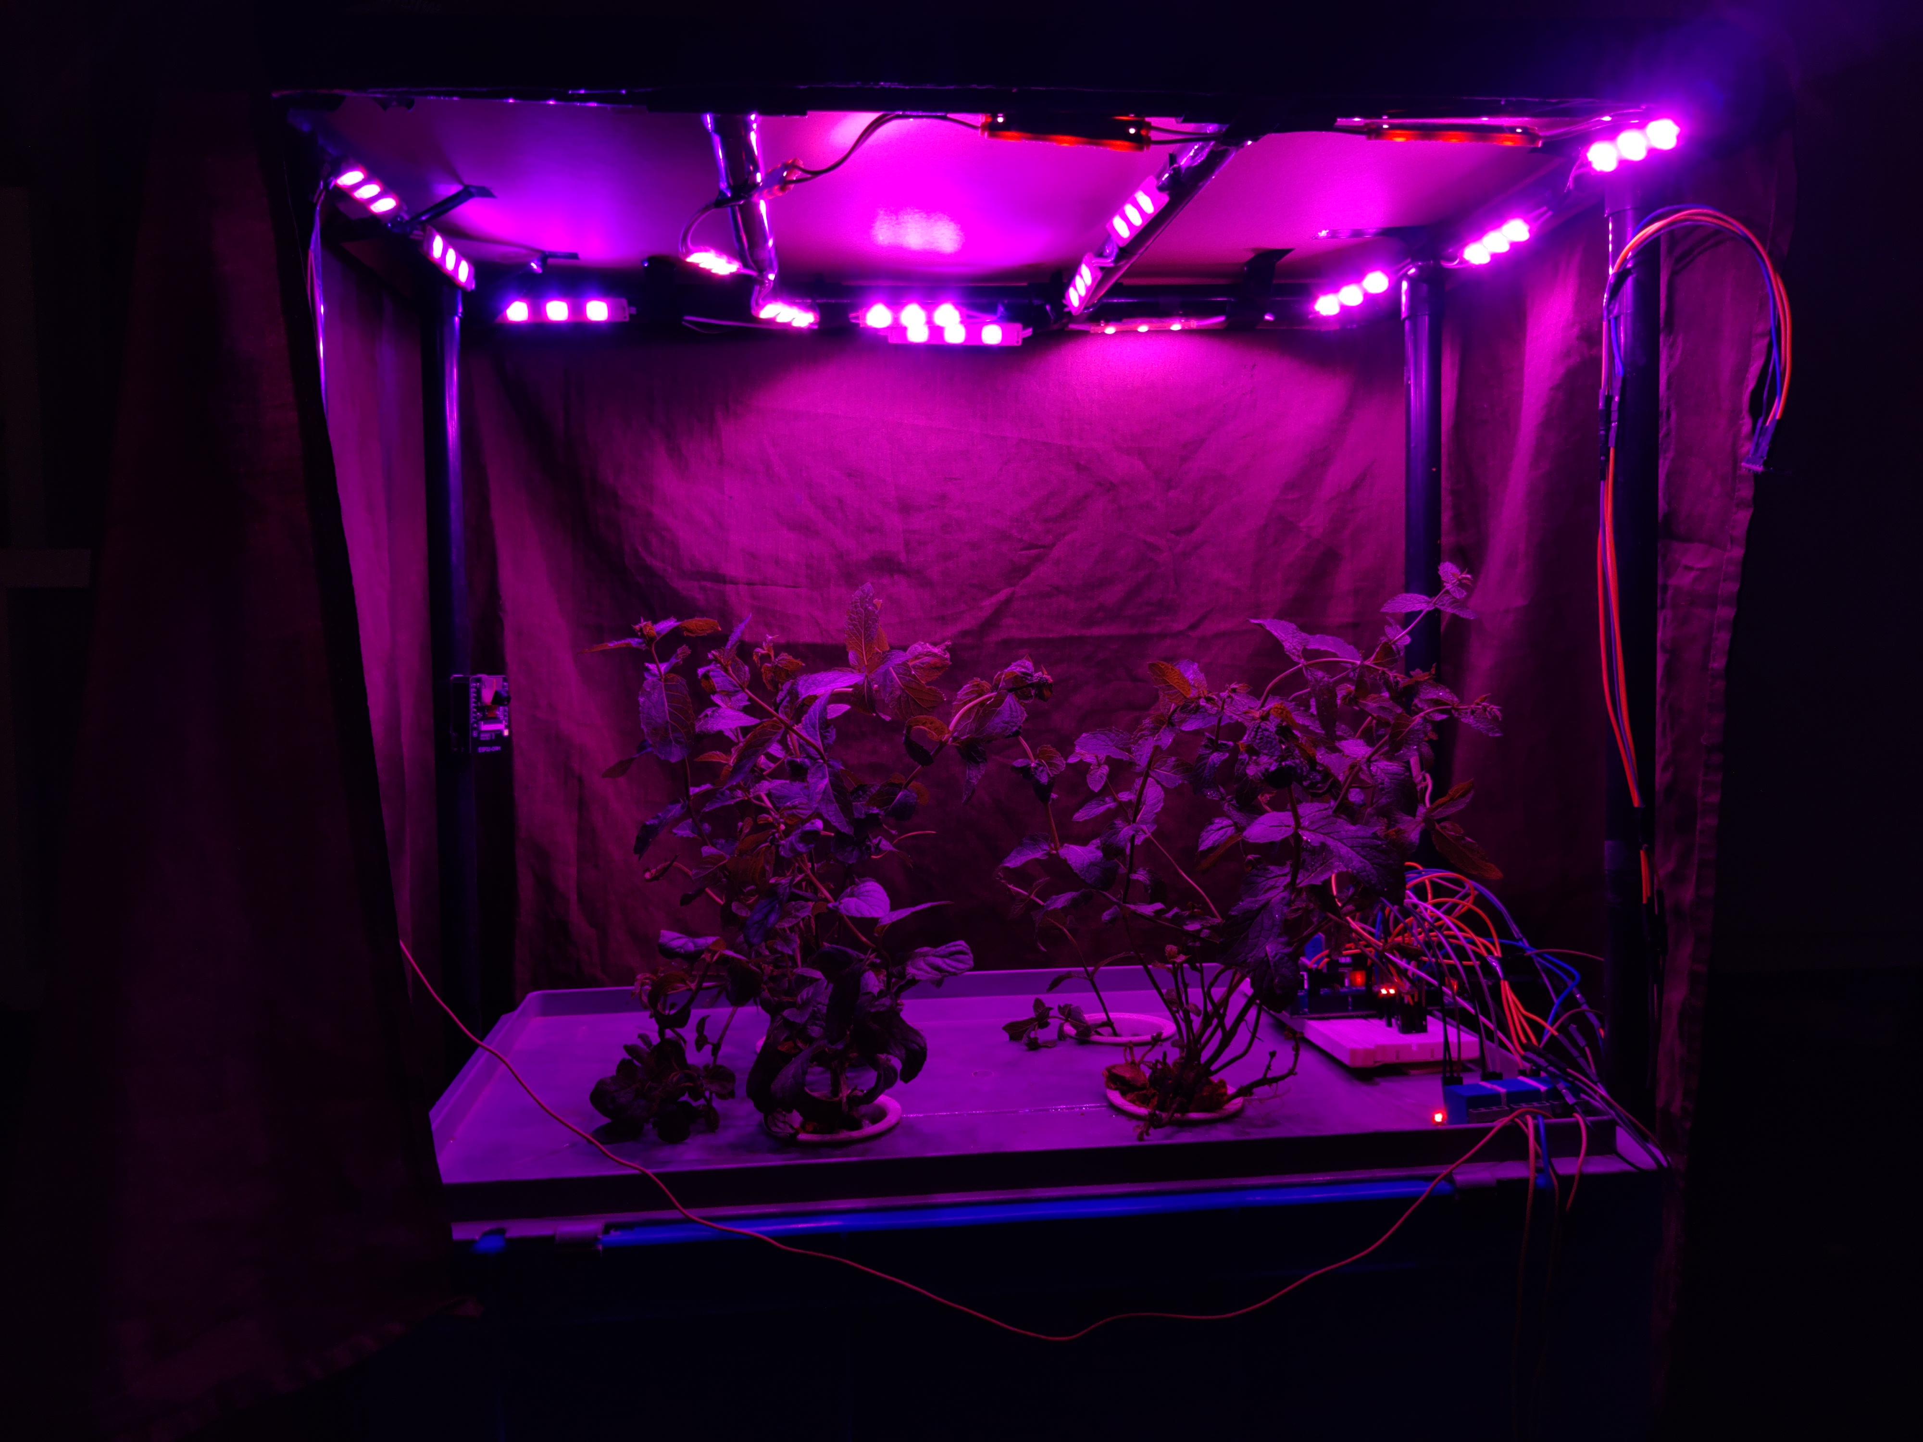
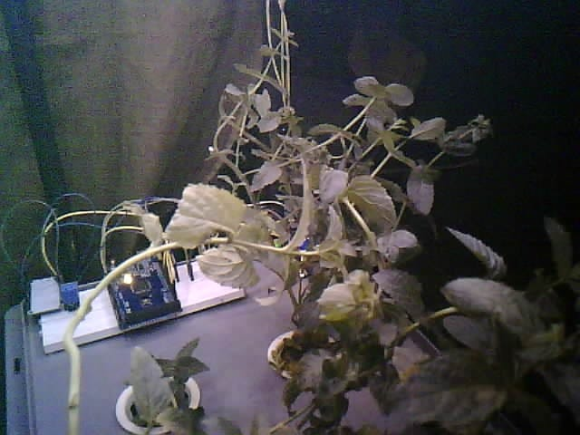
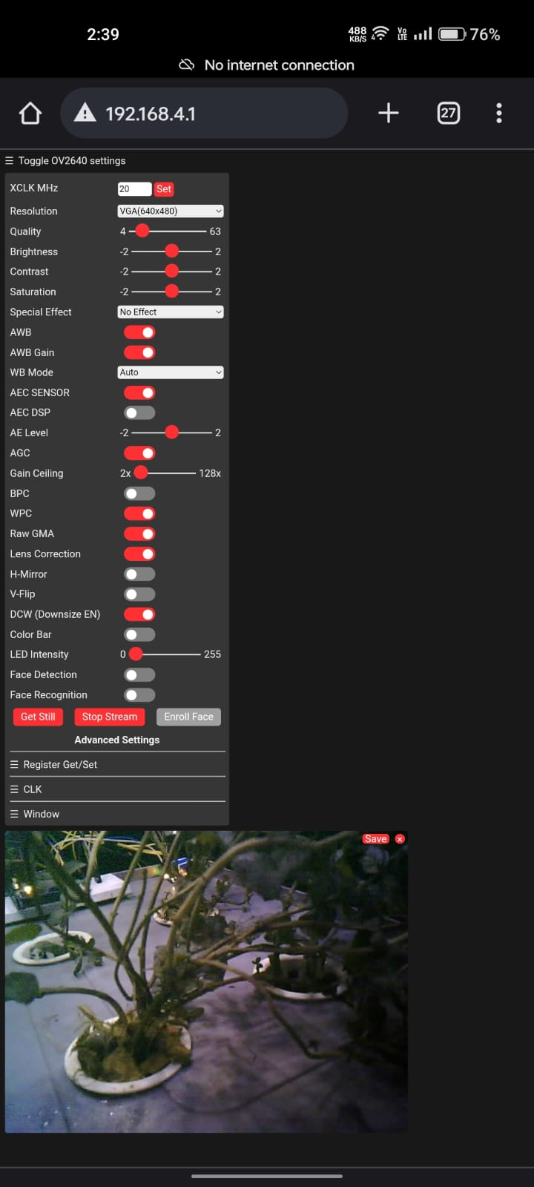
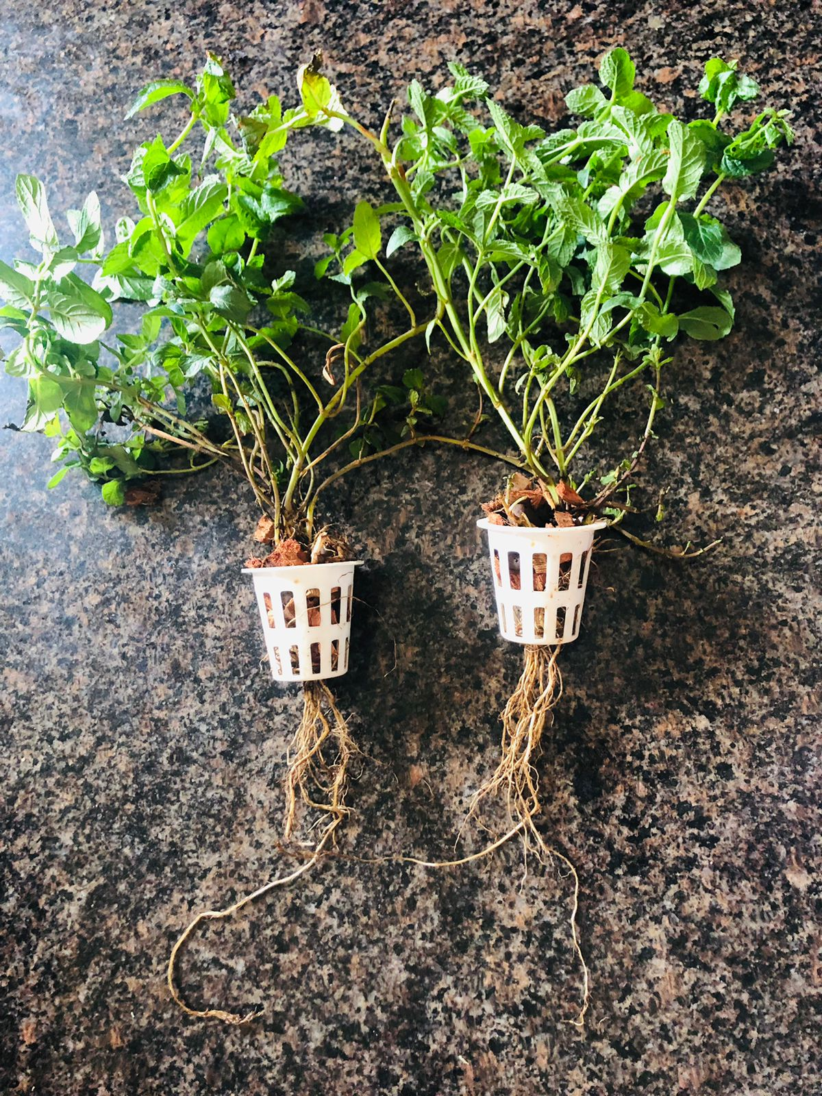
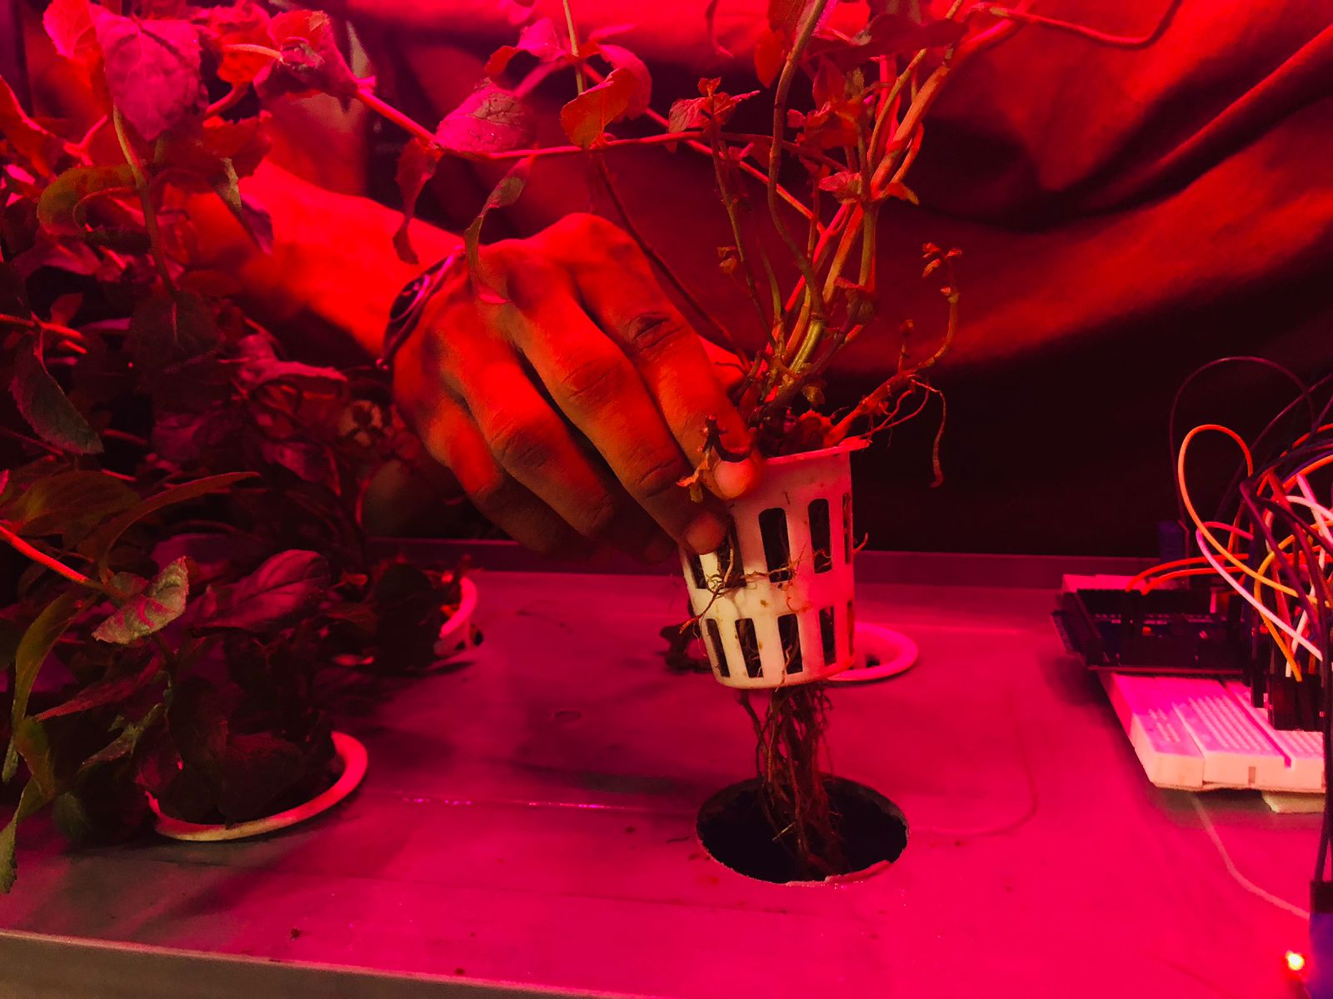
Plant Growth on Day 50

Slide 20
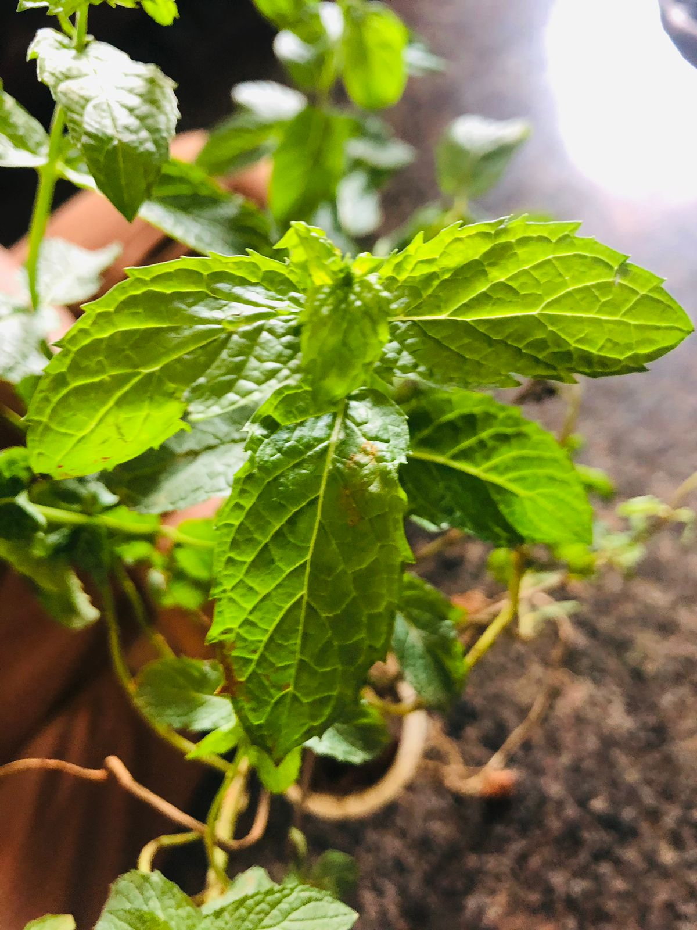
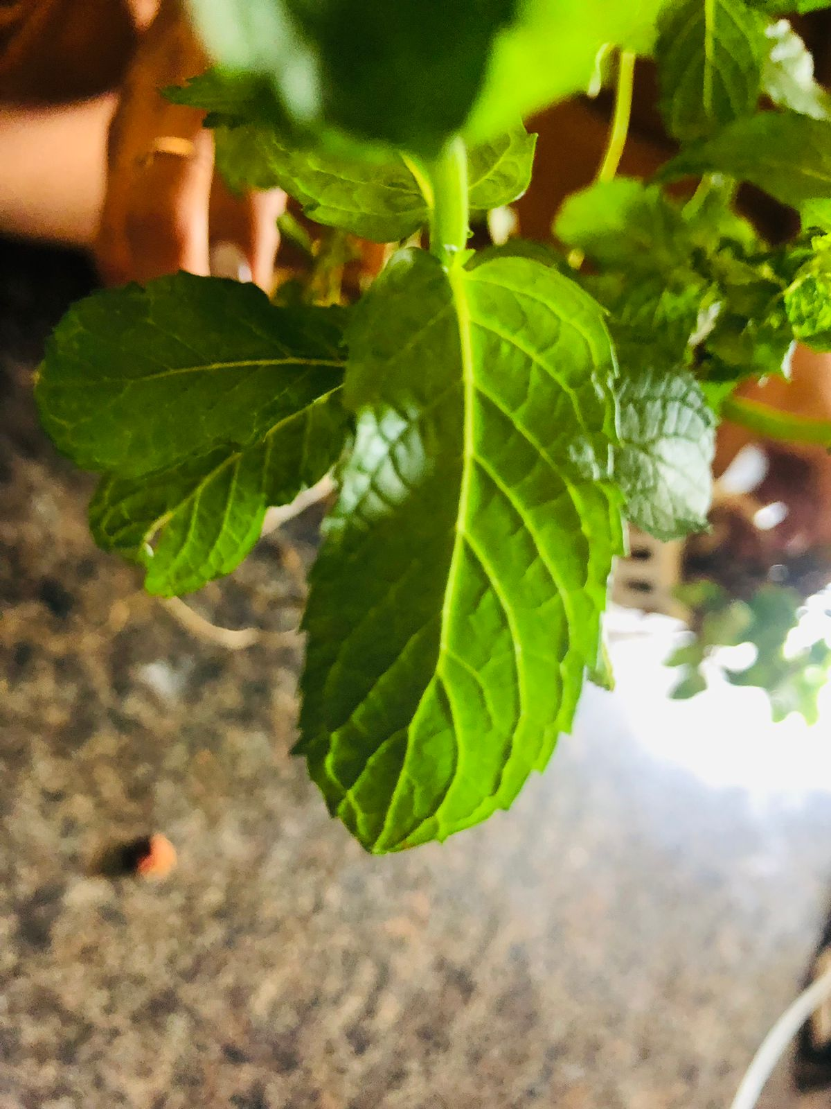
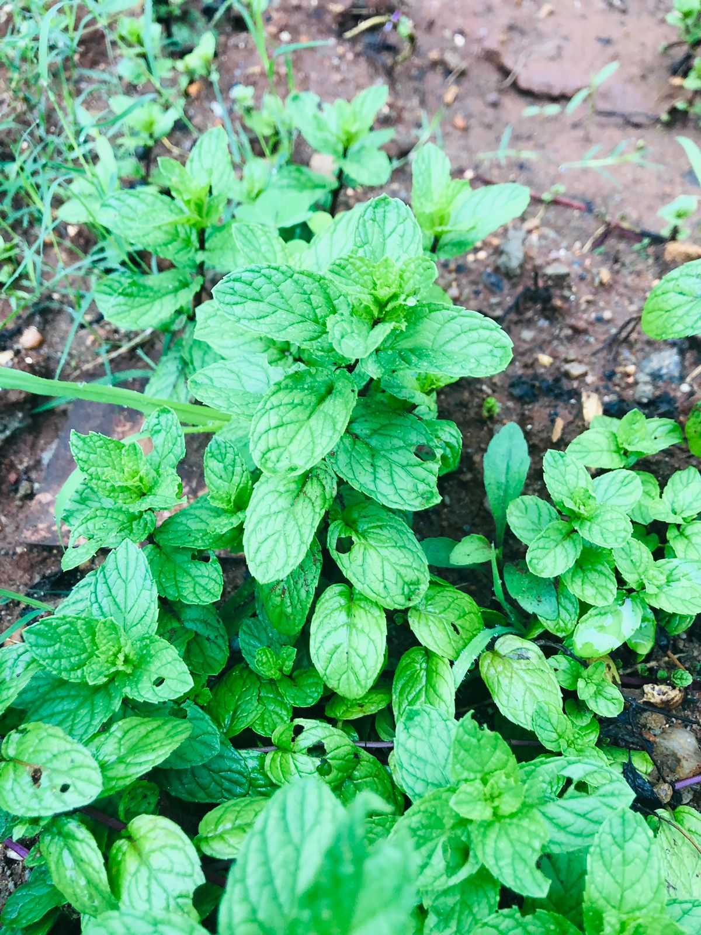
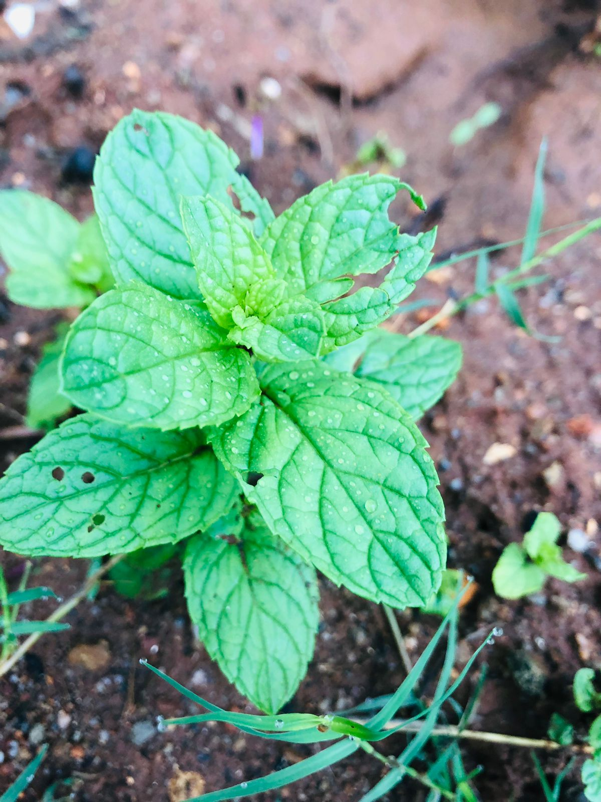
Performance Analysis
Mint Leaves grown through Aeroponics system
Mint Leaves grown through Conventional method

Slide 21
APPLICATION
Can be physically implemented in 3rd world countries.
Can be used in space project.
Easy cultivation can be done in water prone areas.

Slide 22
REFERENCES
[1] "Climate Education for K-12," NC State University, August 16, 2018.
[2] "Progressive Plant Growing is a Blooming Business," NASA, November 30, 2007.
[3] I. Nir, "Apparatus and method for plant growth in aeroponic conditions,” July 12, 2016.
[4] L. W. V. Richard W. Zobel and T. N. Richard F. Lychalk, "AEROPONIC GROWTH SYSTEM WITH NUTRIENT FOG STABILIZATION,” October 27, 2020.
[5] Y. W. Z. Jing Liu, "An Automatic Aeroponics Growth System Based on Ultrasonic Atomization,” February 2019.

Slide 23

THANK YOU

